Slide 1
A Kenyan Online Freelance Marketplace
WILSON GICHUHI
SCT212-0043/2018
A web-based project submitted in fulfilment of the requirements for the award of Computer Technology systems Project

Slide 2
Review of related systems
Upwork - a platform that lets you find your next favourite freelancer by either searching for candidates on the site orposting a job
Toptal- is a professional freelancing marketplace focusing on software engineering.
Fiverr

Slide 3
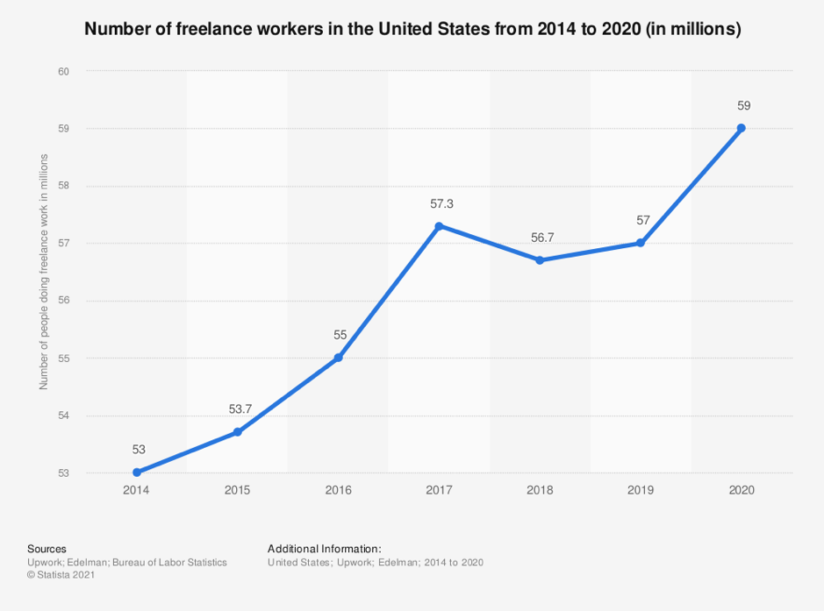

Slide 4
2. Background of research
In Kenya, we have large numbers of professionals complaining that they cannot get jobs.
Companies also claim that they are struggling to find skilled professionals. They need the above mentioned professionals but are afraid of making long term commitments with individuals without sufficient experience and also the cost of managing human capital. .
To overcome this problem, a freelancing marketplace can be used. It will connect talented individuals with economic opportunities and help organisations cut down on the cost of managing human capital by getting professionals to work for them on a short-term basis.
Notes:
In Kenya, we have large numbers of professionals complaining that they cannot get jobs. These professionals are graduating with skills in software development, writing, data entry, design, sciences, sales and marketing, accounting, legal services, etc. They, however, struggle to get started and gain experience in such high-in-demand industries. It is because the jobs require experience and they require jobs to get experience. Companies also claim that they are struggling to find skilled professionals. (Roussi and Financial Times, 2021) We have multiple companies and organisations that need the abovementioned professionals but are afraid of making long term commitments with individuals without sufficient experience due to legal risk and the cost of managing human capital. To overcome these problems, a freelancing marketplace can be used. It will connect talented individuals with economic opportunities and help organisations cut down on the cost of managing human capital by getting individuals to work for them on a short-term basis. This is already being used in Europe and in the USA wherein 2019, an MBO Partners’ survey found that nearly 41.1 million Americans identified themselves as freelancers, whether it was a few hours a month or a full-time arrangement. To break that down a little further, nearly 15 million workers claimed to be part-time freelancers, and 12.4 million called themselves full-time freelancers! (MBO Partners, 2019)

Slide 5
3. Problem statement
We have a huge number of professionals graduating with high in-demand skills. They, however, struggle to get started and gain experience in these industries. Jobs require experience and they require jobs to get experience. The technology used in the hiring and selection process is not optimised to showcase their potential. It majorly focuses on experience.

Slide 6
4. Aim of research
Create a digital freelancing marketplace that will connect talented professionals with economic opportunities and give organisations access to affordable and low-risk human capital.
State of the art: Freelance and outsourcing in Kenya

Slide 7
5. Scope of the research
1. Allow freelancers to have online profiles.
2. Allow freelancers to be paid via easy methods like M-Pesa.
3. Money to be held in escrow to help in preventing fraud.
4. Allow companies, organisations and individuals (job posters) to post jobs.
5. Allow the job posters to receive bids on the job from qualified freelancers.
6. Allow the job posters to review freelancer profiles to help them with the selection.
7. After being given a job freelancers work then submit when done. The client has the right to reject/approve the work.
8. Ratings and reviews for both clients and freelancers after jobs.
9. Notifications. The system should be able to notify the freelancers and job posters of actions that require their attention.
10. Admin section and generation of reports. There should be an admin app that can be used to manage customers, freelancers and postings. There will be reports like jobs posted, user logs, etc.

Slide 8
6. Implementation
I will go through materials of recent research on such systems as well as an overview of other similar products.
Final draft will include system analysis with Diagrams and Flow charts. I will also use ERD diagrams and Use case diagrams for the system design.
The system will be implemented using various technologies like PHP, HTML, CSS, JavaScript and MySQL.

Slide 9
7. Functional Requirements
1. User Login, Register, or update profiles and passwords
2. Register as a client or Freelancer
3. Create and Select Job by categories
4. Handle payments, ratings, and refunds

Slide 10
8. Non functional Requirements
1. Speedy performance - client side caching
2. Maintanable application - Dockirized and automated release pipelines
3. Automatic disaster recovery, backup plans and procedures must be introduced to ensure
reliability(DB Backups scheduled).
4. Security – All passwords are hashed; clients, admins and freelancers all have different
dashboards with different permissions; all user input should be verified and validated, and users
should be notified if any problems are identified while using the system.

Slide 11
9. Database Design
This was done with the help of an ERD diagram that is in next slide.

Slide 12
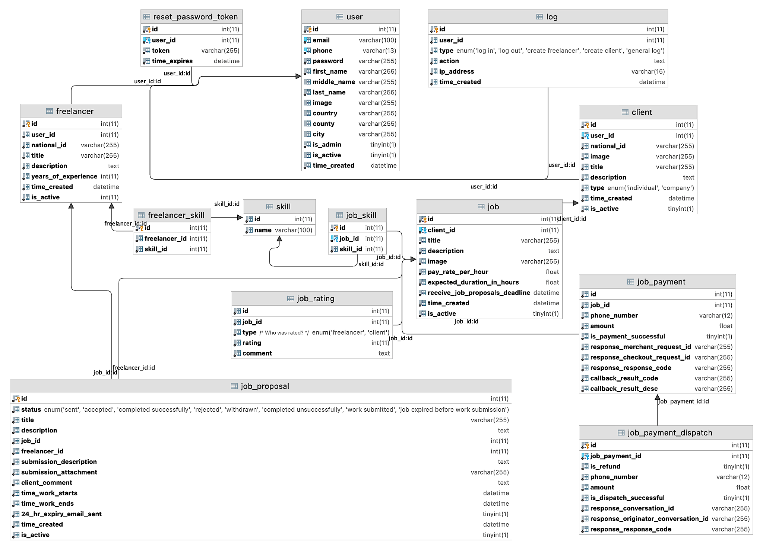

Slide 13
10. Conclusion
Clients and freelancers can now with a click of a few buttons and browser interactions join a platform that truly works towards achieving a goal of connecting talented professionals with economic opportunities and giving organisations access to affordable and low-risk human capital.
People can now utilize their skillset and make a living out of them, dependent on how well they advance in the freelance community.
Organizations on the other hand have a huge pool of competent individuals willing to put in the work, and support them as if they were employed by them.

Slide 14
11. Future recommendations
1. An online communication platform should be added for clients to communicate with freelancers, for example, via video calls or inApp messaging.
2. Improve the User Experience by creating a seamless omnichannel for Mobile and other devices
3. More payment systems should be added to allow for a better reach.
4. The system should be expanded to be used outside Kenya and Africa.
5. Add a facial recognition system to for users to verify that they are the ones on the national ID documents they submitted.
6. Add a translation of the site to Kiswahili and French to access more users in Kenya and Africa.
7. Add internal HR System to help manage employees onboarding, leave management and payrolls.
8. Offer scalable Cloud-native hosting

